Slide 1
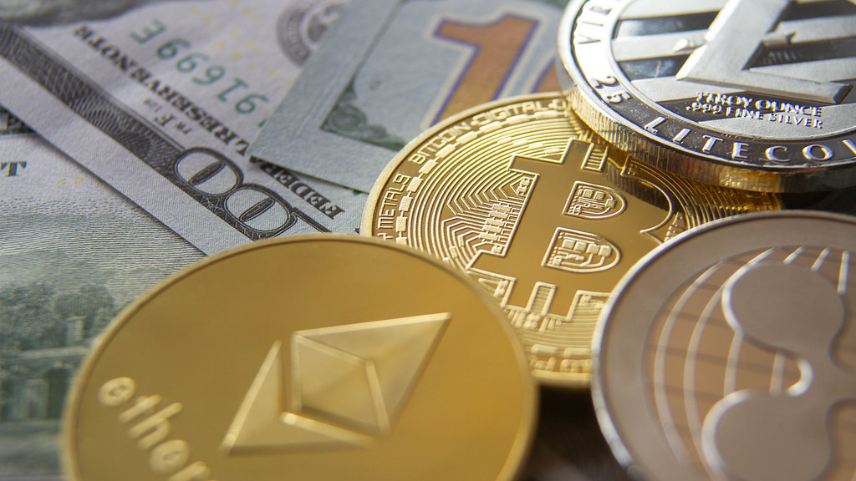
Stablecoins
Abel Sanchez, John R Williams

Slide 2



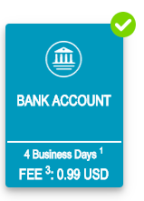
Money Transfer
Alice
$10
$9.01
4 Business Days
Bob

Slide 3

Open Ledger
$5
Alice
Bob
Alice $10
Alice ➔ Bob $5
$3
Bob ➔ Carol $3
Carol ➔ Dave $1
Dave
Carol
$1

Slide 4
Chain: Alice ➔ Bob ➔ Carol ➔ Dave
$5
Alice
Bob
Alice $10
Open
Public
To Everyone
Funds Visible
Alice ➔ Bob $5
$3
Bob ➔ Carol $3
Carol ➔ Dave $1
Dave
Carol
$1

Slide 5

Chain: Alice ➔ Dave, $20
$5
Alice
Bob
Alice $10
Alice ➔ Bob $5
Fail: $20
$3
Bob ➔ Carol $3
Carol ➔ Dave $1
Dave
Carol
Alice ➔ Dave $15
$1

Slide 6
Distributed Open Ledger
$5
Alice $10
X
Alice $10
Alice ➔ Bob $5
Alice ➔ Bob $5
Bob ➔ Carol $3
Bob ➔ Carol $3
Carol ➔ Dave $1
Alice
Bob
Carol ➔ Dave $1
Alice $10
Alice ➔ Bob $5
$3
Bob ➔ Carol $3
Carol ➔ Dave $1
Dave
Carol
Alice $10
Alice $10
Alice ➔ Bob $5
Alice ➔ Bob $5
Bob ➔ Carol $3
Bob ➔ Carol $3
Carol ➔ Dave $1
Carol ➔ Dave $1
$1

Slide 7
Distributed Open Ledger
$5
Alice $10
Alice $10
Alice ➔ Bob $5
Alice ➔ Bob $5
Bob ➔ Carol $3
Bob ➔ Carol $3
Carol ➔ Dave $1
Alice
Bob
Carol ➔ Dave $1
$3
Dave
Carol
Alice $10
Alice $10
Alice ➔ Bob $5
Alice ➔ Bob $5
Bob ➔ Carol $3
Bob ➔ Carol $3
Carol ➔ Dave $1
Carol ➔ Dave $1
$1

Slide 8
Consensus
$5
Alice $10
Alice $10
Alice ➔ Bob $5
Alice ➔ Bob $5
Bob ➔ Carol $3
Bob ➔ Carol $3
Carol ➔ Dave $1
Alice
Bob
Carol ➔ Dave $1
$1
Proposed Transaction
Bob ➔ Dave $1
$3
Dave
Carol
Alice $10
Alice $10
Alice ➔ Bob $5
Alice ➔ Bob $5
Bob ➔ Carol $3
Bob ➔ Carol $3
Carol ➔ Dave $1
Carol ➔ Dave $1
$1

Slide 9
No Trust Needed
Alice
$10
X
X
X
$9.01
4 Business Days
Bob

Slide 10
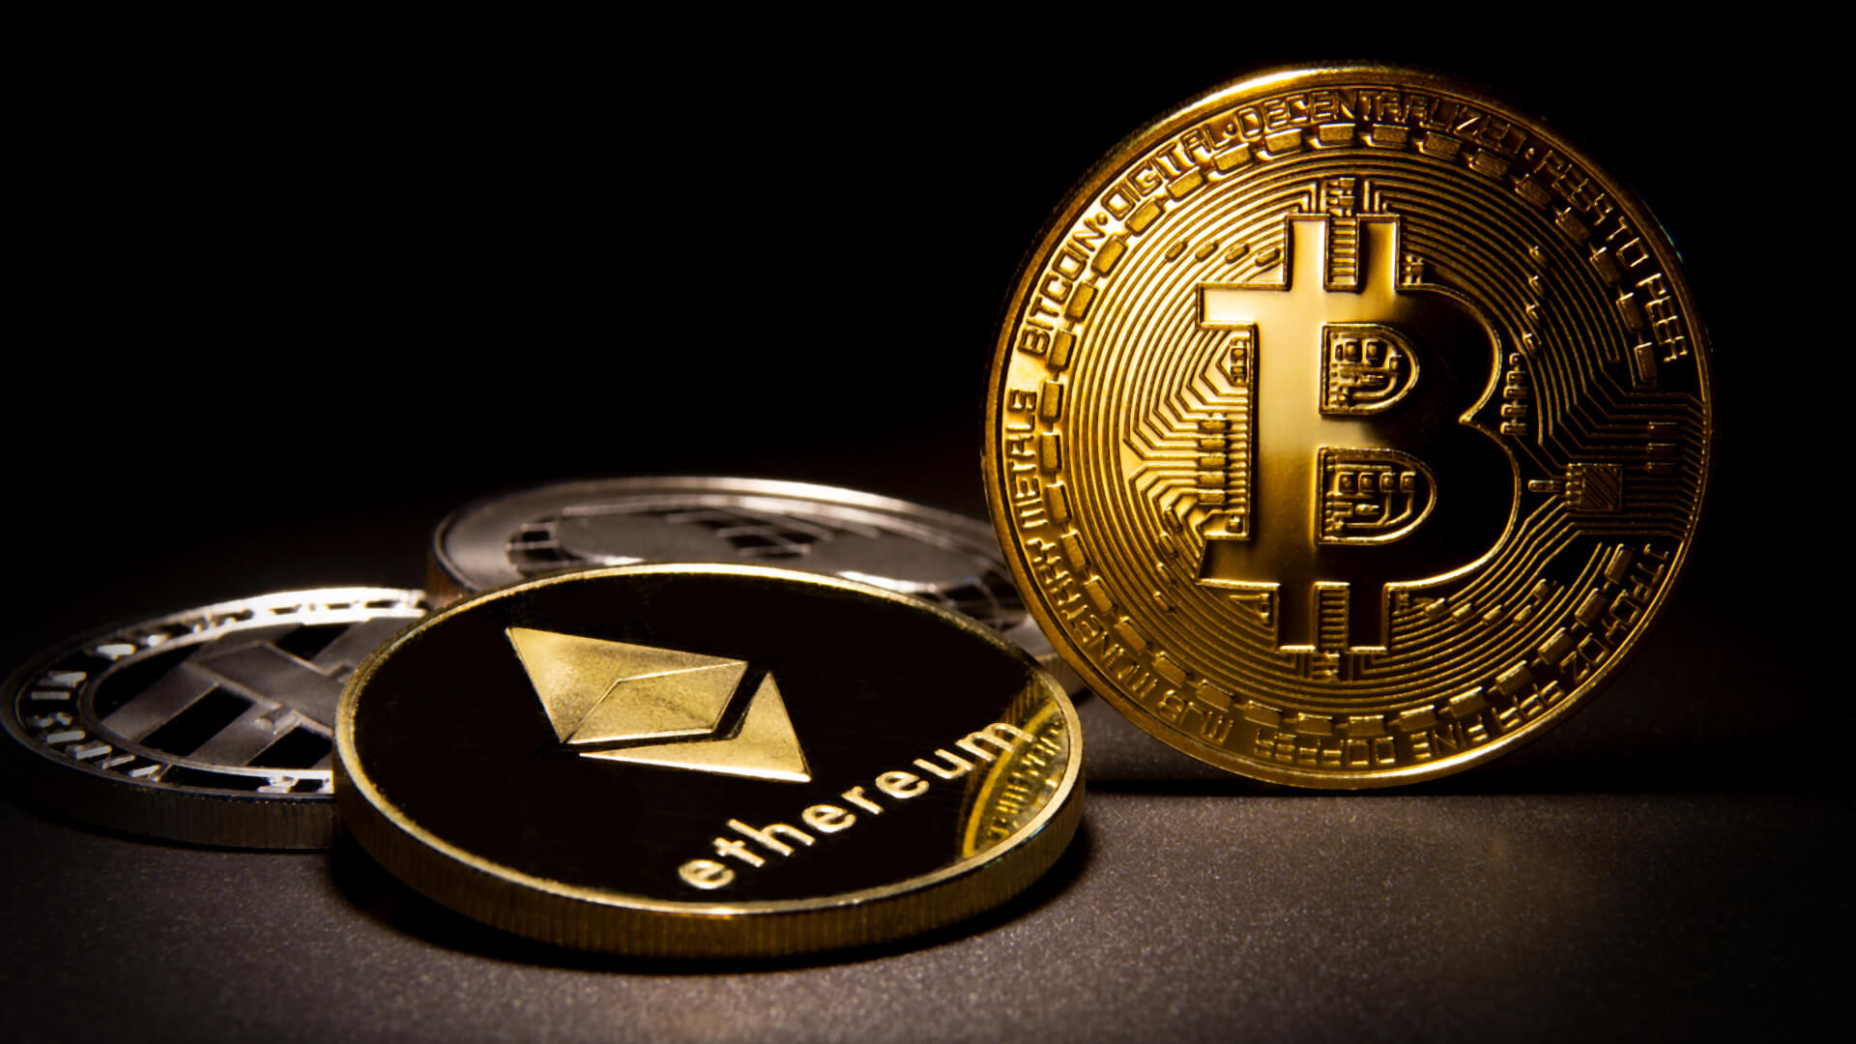

Slide 11
Bitcoin & ether
Dominant cryptocurrencies
Prices are volatile
Speculation can fuel volatility, which fuels further speculation
Volatility can hinder adoption

Slide 12
Drawbacks of Volatile Cryptocurrencies I
Unnecessary currency risk
Paying salary in bitcoin is problematic
Wages keep fluctuating
Difficulty to transact with
Blockchain-based loans
Derivatives
Prediction markets
Long-term smart contracts
No price stability
Users who do not want to speculate

Slide 13
Drawbacks of Volatile Cryptocurrencies II
Users who do not want to speculate
Want to store money
Want to use money
Want a censorship resistant ledger
Hinders long term dapps that require price stability

Slide 14

Consumer
Confidence

Slide 15

Stablecoin

Slide 16

Fiat Collateralized

Slide 17

Stablecoin
Fiat Collateralized

Slide 18
Fiat-collateralized Coin
Is backed by real-world currency like USD.
I works by depositing USD into a bank account and issuing stable coins in a one-to-one ratio against those USD
When a user wants to liquidate their stablecoins, you destroy their stable coins, and wire USD

Slide 19
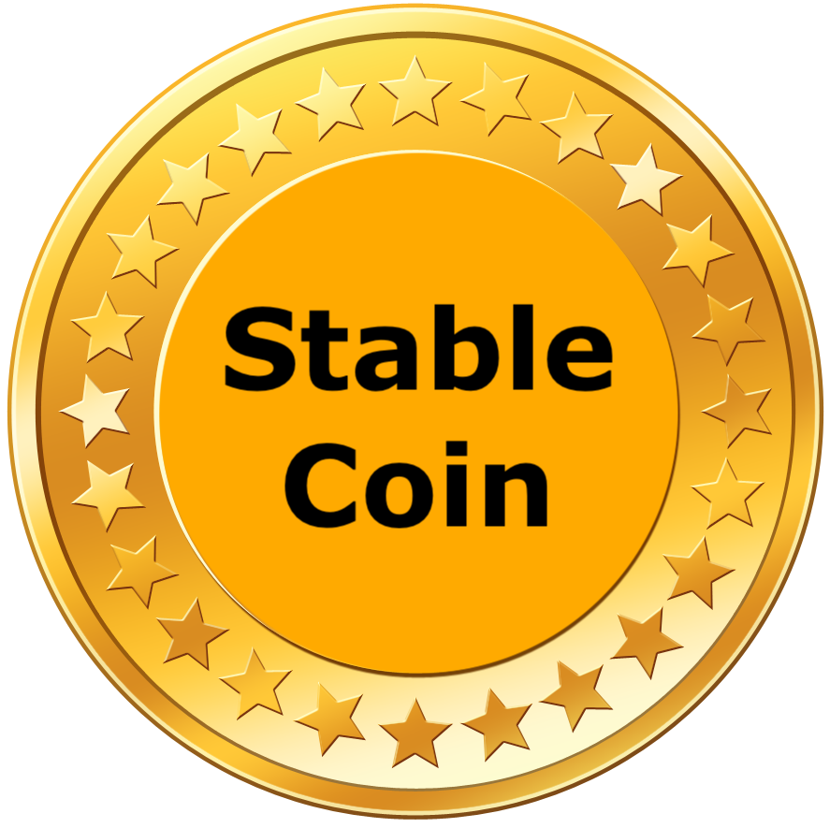


Fiat-collateralized Coin

Slide 20

Fiat-collateralized Coin

Slide 21
Fiat-collateralized Coin
destroy coin

Slide 22
Fiat-collateralized Coin
1-to-1

Slide 23
Advantages
Simplest
100% price stable
Less vulnerable to hacks since no collateral held on blockchain

Slide 24
Disadvantages
Centralized as a custodian must store the fiat
Need audits to ensure transparency
Highly regulated
Government interference
Expensive and slow liquidation to fiat
Slow gateways to traditional currencies

Slide 25
Stablecoins
USDC, Circle & Coinbase
Libra, Facebook

Slide 26
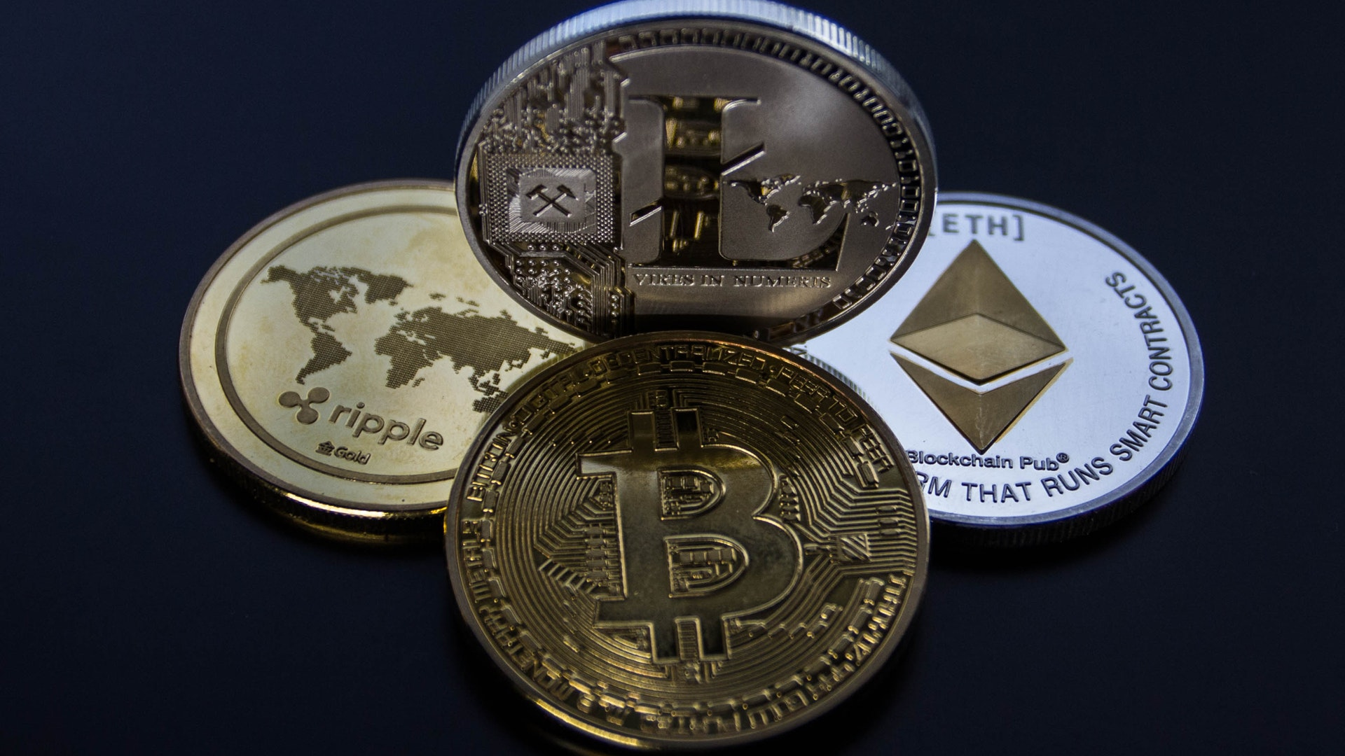
Crypto Collateralized

Slide 27
Crypto-collateralized coins
Operate in the same way as fiat-backed stablecoins but backed with reserved from another cryptocurrency
The entire system can live on the blockchain
Decentralized

Slide 28

Collateralization Ratio?
Collateralization Ratio
Fiat-collateralized
Crypto-collateralized

Slide 29
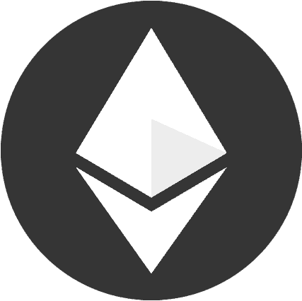
Fiat-collateralized
Crypto-collateralized

Slide 30
Fiat-collateralized
Crypto-collateralized

Slide 31
Advantages
More decentralized
Can liquidate cheaply and quickly into underlying crypto collateral
Easy for everyone to inspect the collateralization ratio of the stablecoin

Slide 32
Disadvantages
Less price stable than fiat
Can be auto-liquidated during a price crash
Tied to the health of a particular cryptocurrency
Inefficient use of capital
Highest complexity

Slide 33
Stablecoins
Maker DAO, Dai

Slide 34
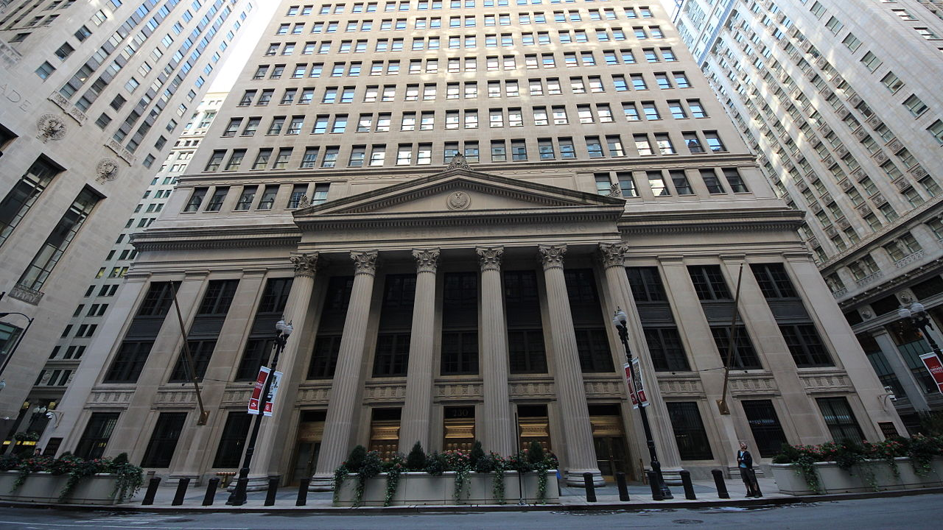
Non-Collateralized

Slide 35
Non-collateralized coins
Based on supply and demand like fiat
Functions of the central bank performed by smart contracts
Oracles monitor price of stablecoins on exchanges
Will create new coins when price goes up
Will buy back and destroy coins when price goes down

Slide 36
Advantages
No collateral required
Most decentralized and independent
Not tied to any cryptocurrency or fiat

Slide 37
Disadvantages
Most vulnerable to crypto decline or crash with no ability to liquidate
Some complexity
Difficult to analyze safety bounds or health
Requires continual growth

Slide 38
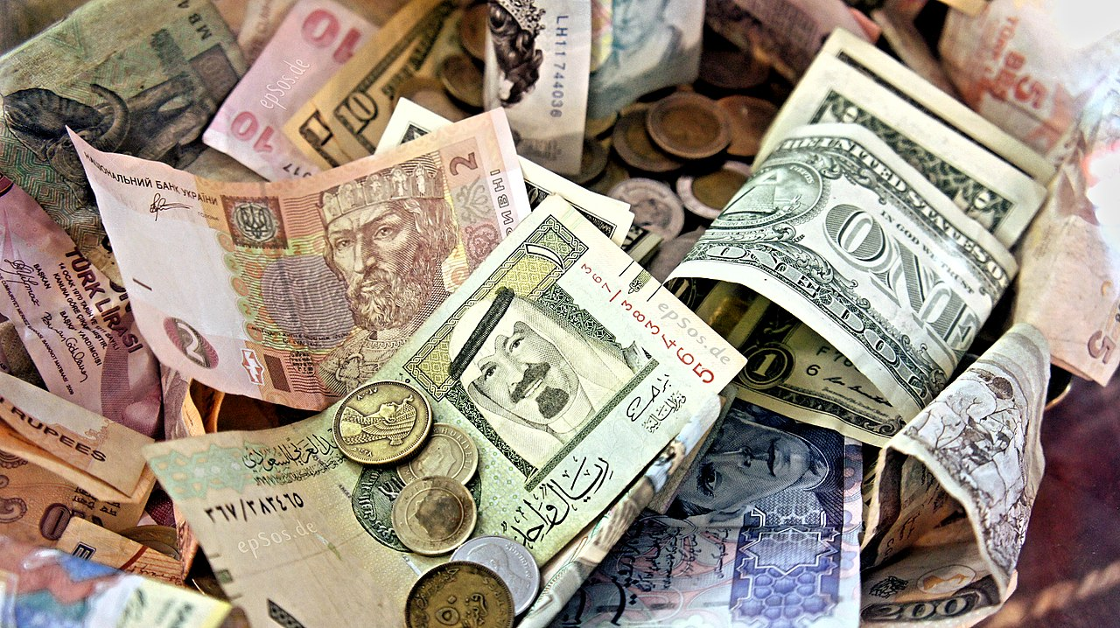

Slide 39
Stablecoins
Basis coin
Reserve coin

Slide 40
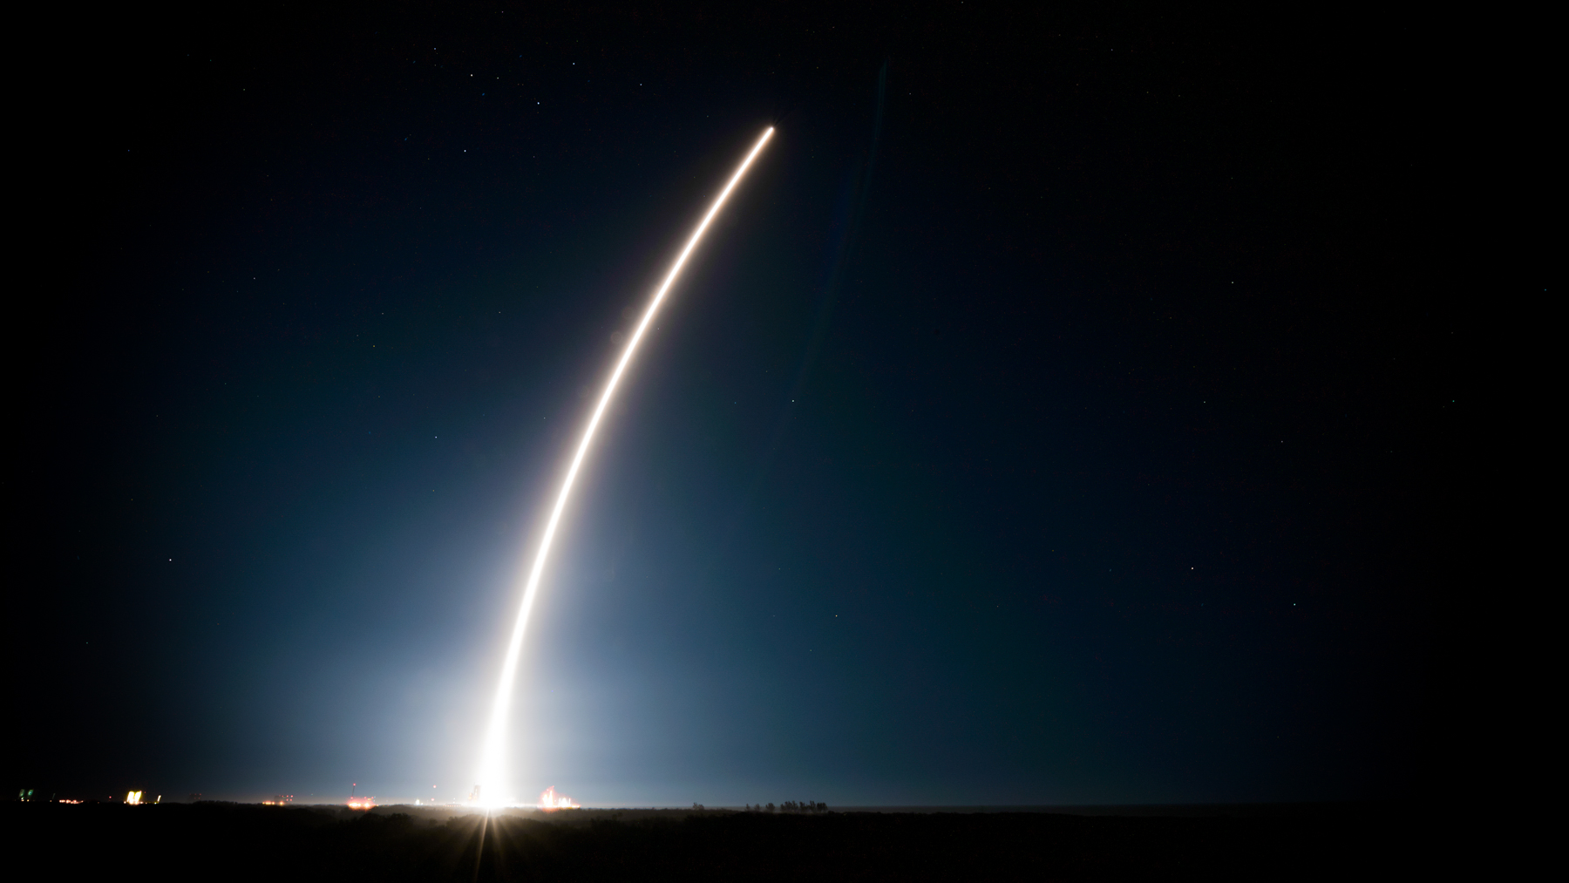

Slide 41


Slide 42
